Slide 1
Aeronautical Mobile Telemetry
Benjamin Havens, Gustavo Oliveira, Joseph Lamb, Preston Walker, Riley Kirkwood

Slide 2
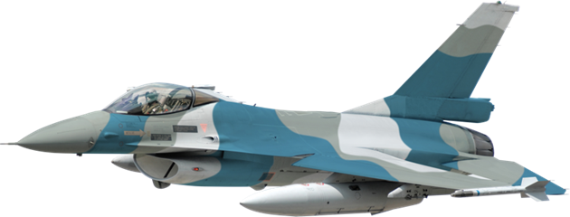
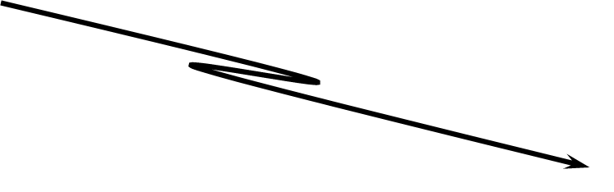

Overview
Telemetry of Airborne Test Articles
Measurements:
Stresses
Strains
Location
Speed
From Dr. Rice

Slide 3
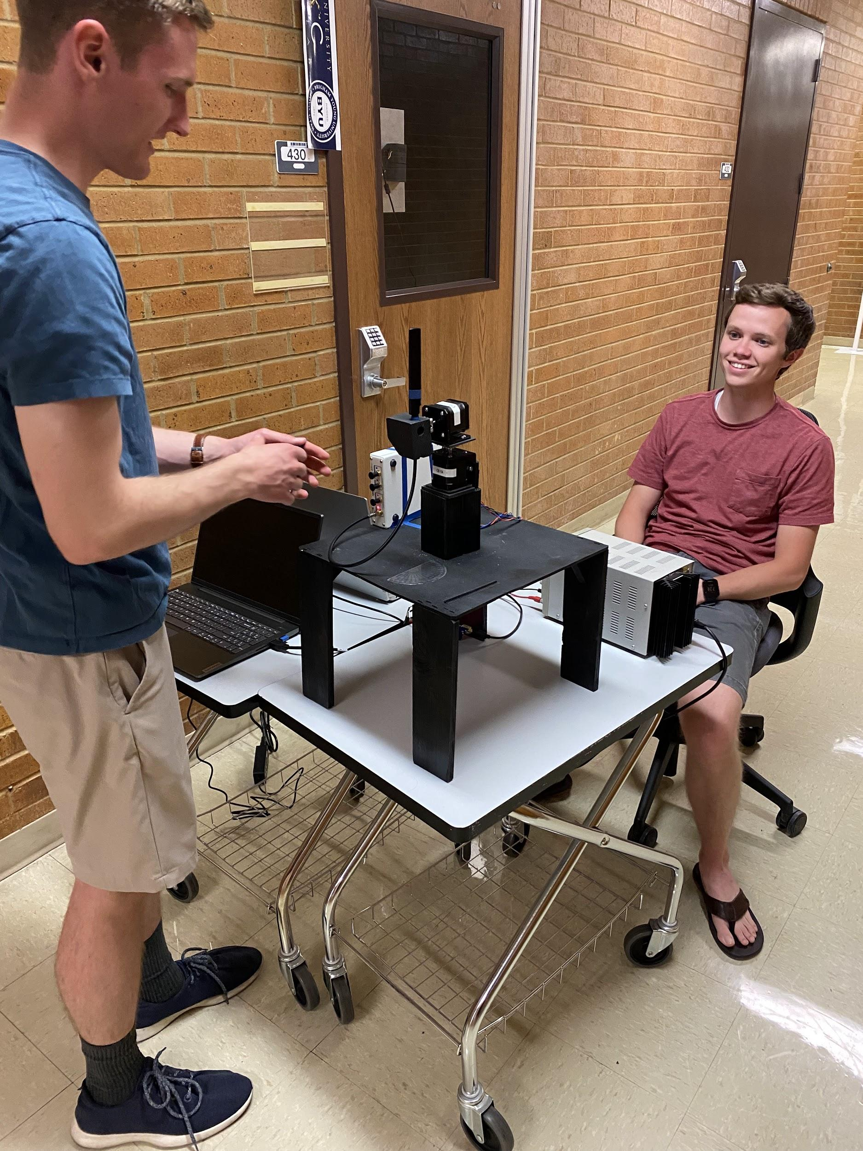
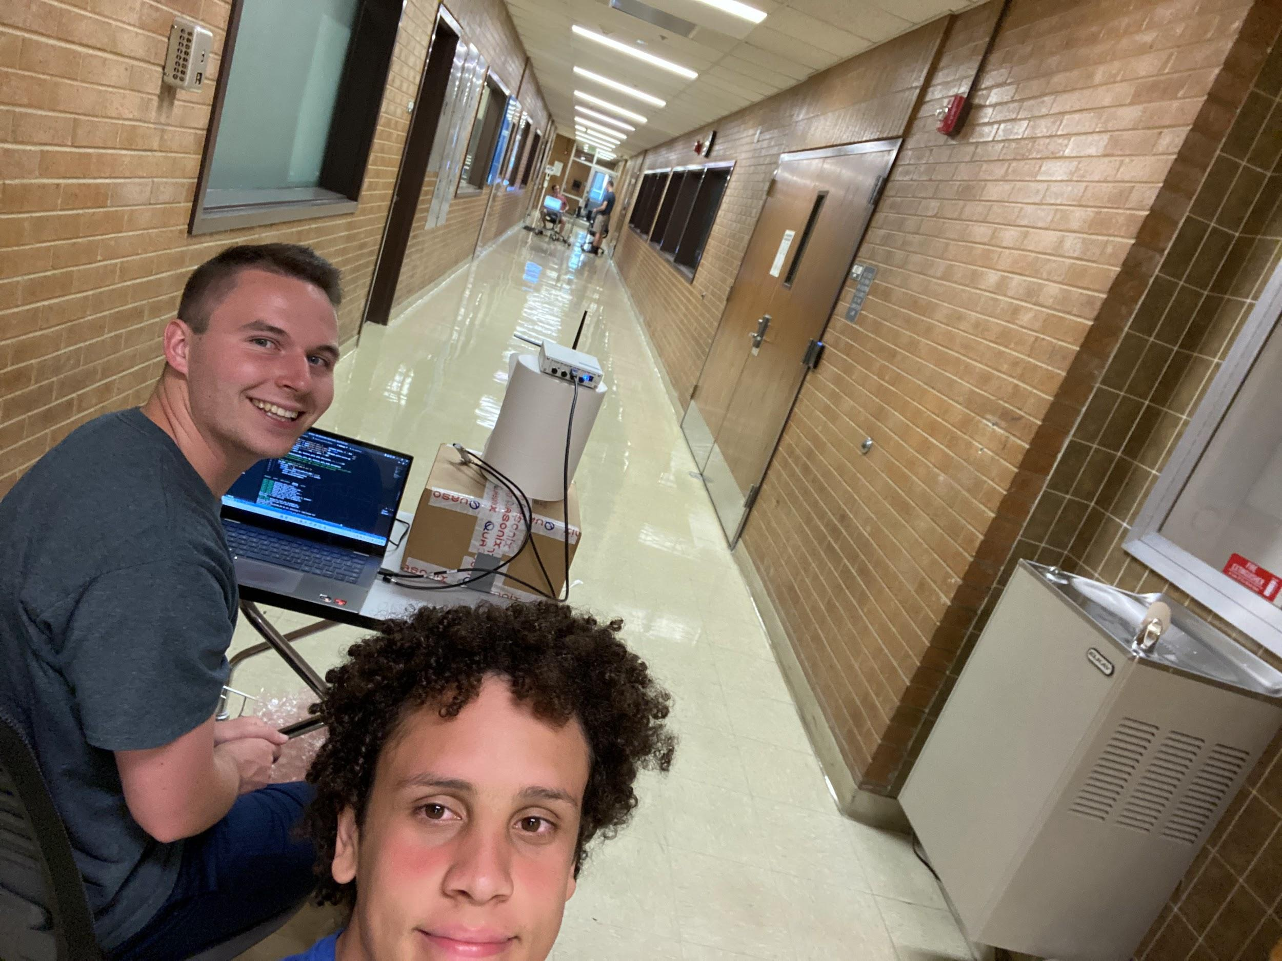
How Our Experiment Relates
Test antennas at various angles
Discover hallways effect on signal
Use math and code to remove noise

Slide 4
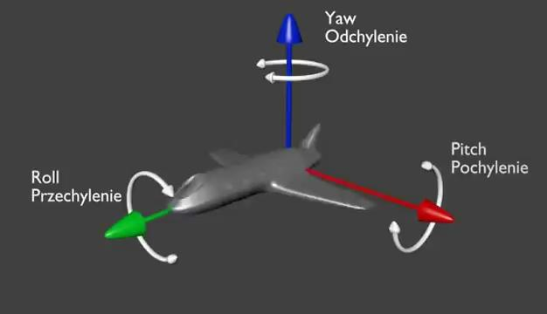
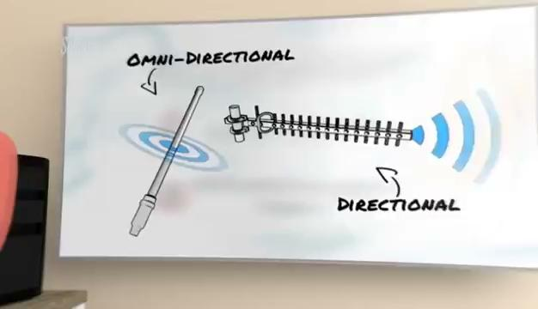
Transmission

Slide 5
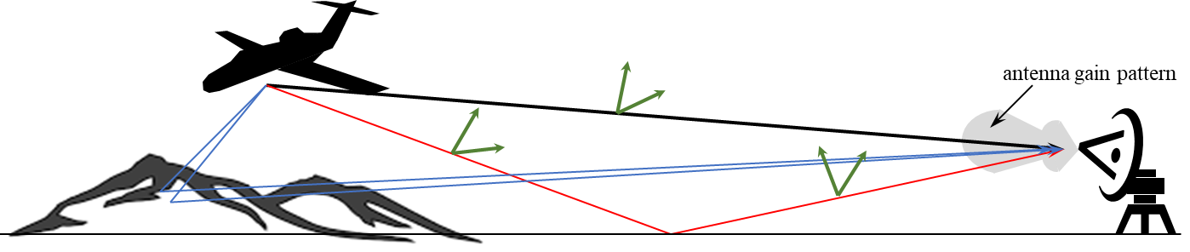
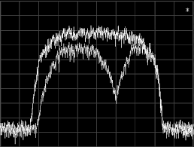
Multipath Propagation (Issue 1)
Line of Sight Transmission
Direct line to receiver
Specular Transmission
Reflection off of ground or object
Diffuse Transmission
Scattered reflection that goes everywhere

Slide 6
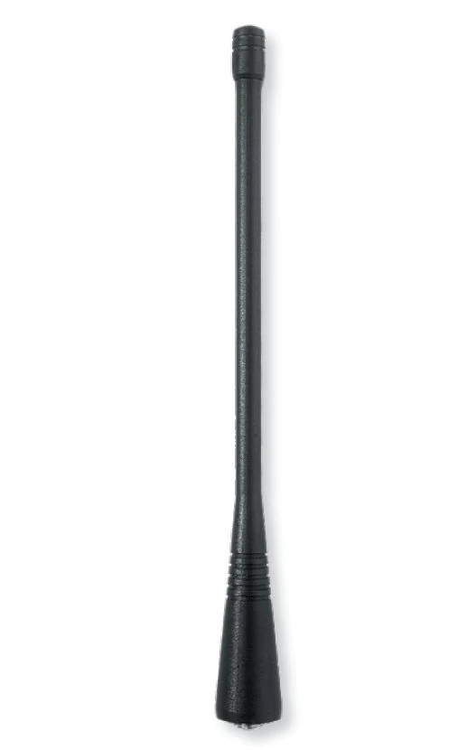
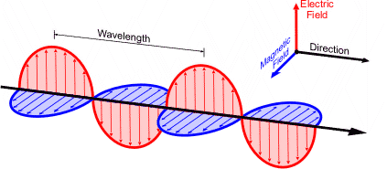
Cross Polarization (Issue 2)
Cross-polarization is when an antenna’s dipoles form a (+) sign or a cross (x) shape. They are oriented at right angles (90º) to each other.

Slide 7
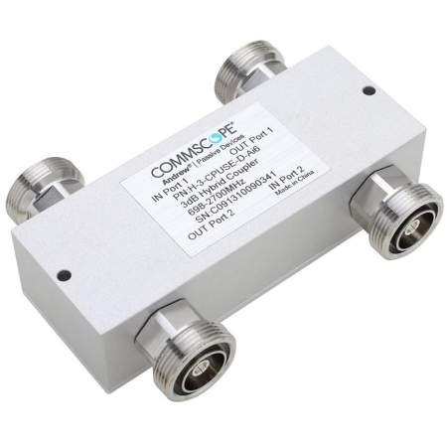

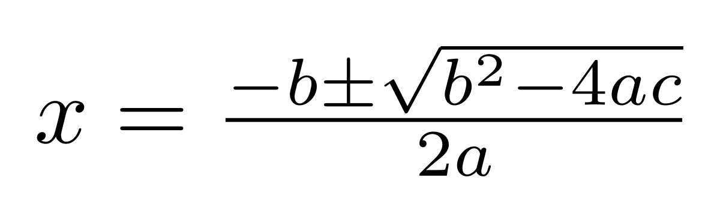
MRC VS ML
Maximum Ratio Combining (Current)
The signals from each channel are added together
3 dB loss of signal
Uses a hybrid coupler
Maximum Likelihood (Our Way)
Is a method of estimating the parameters of an assumed probability distribution, given some observed data
No hybrid coupler
Just statistics and proofs

Slide 8
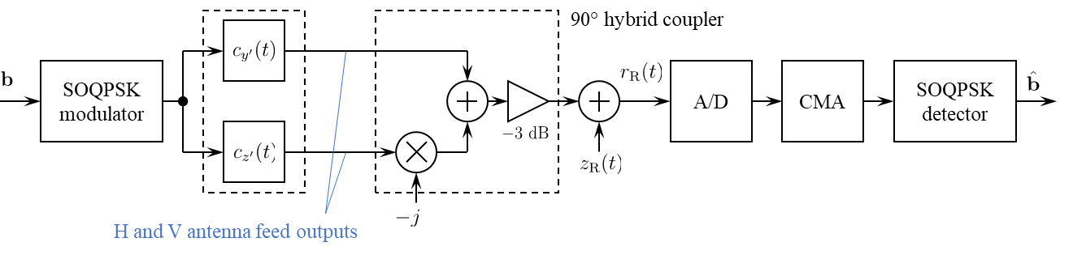
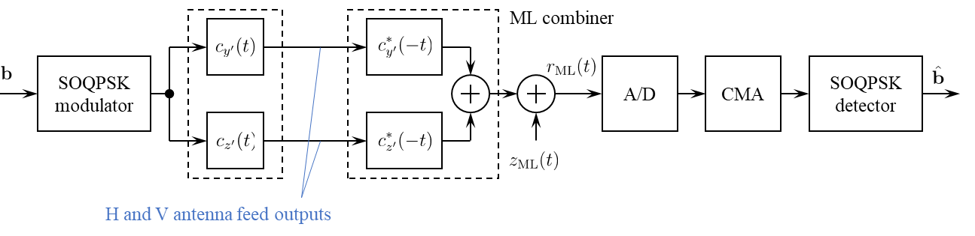
Diagrams for MRC and ML
Maximum Ratio Combining
Maximum Likelihood

Slide 9
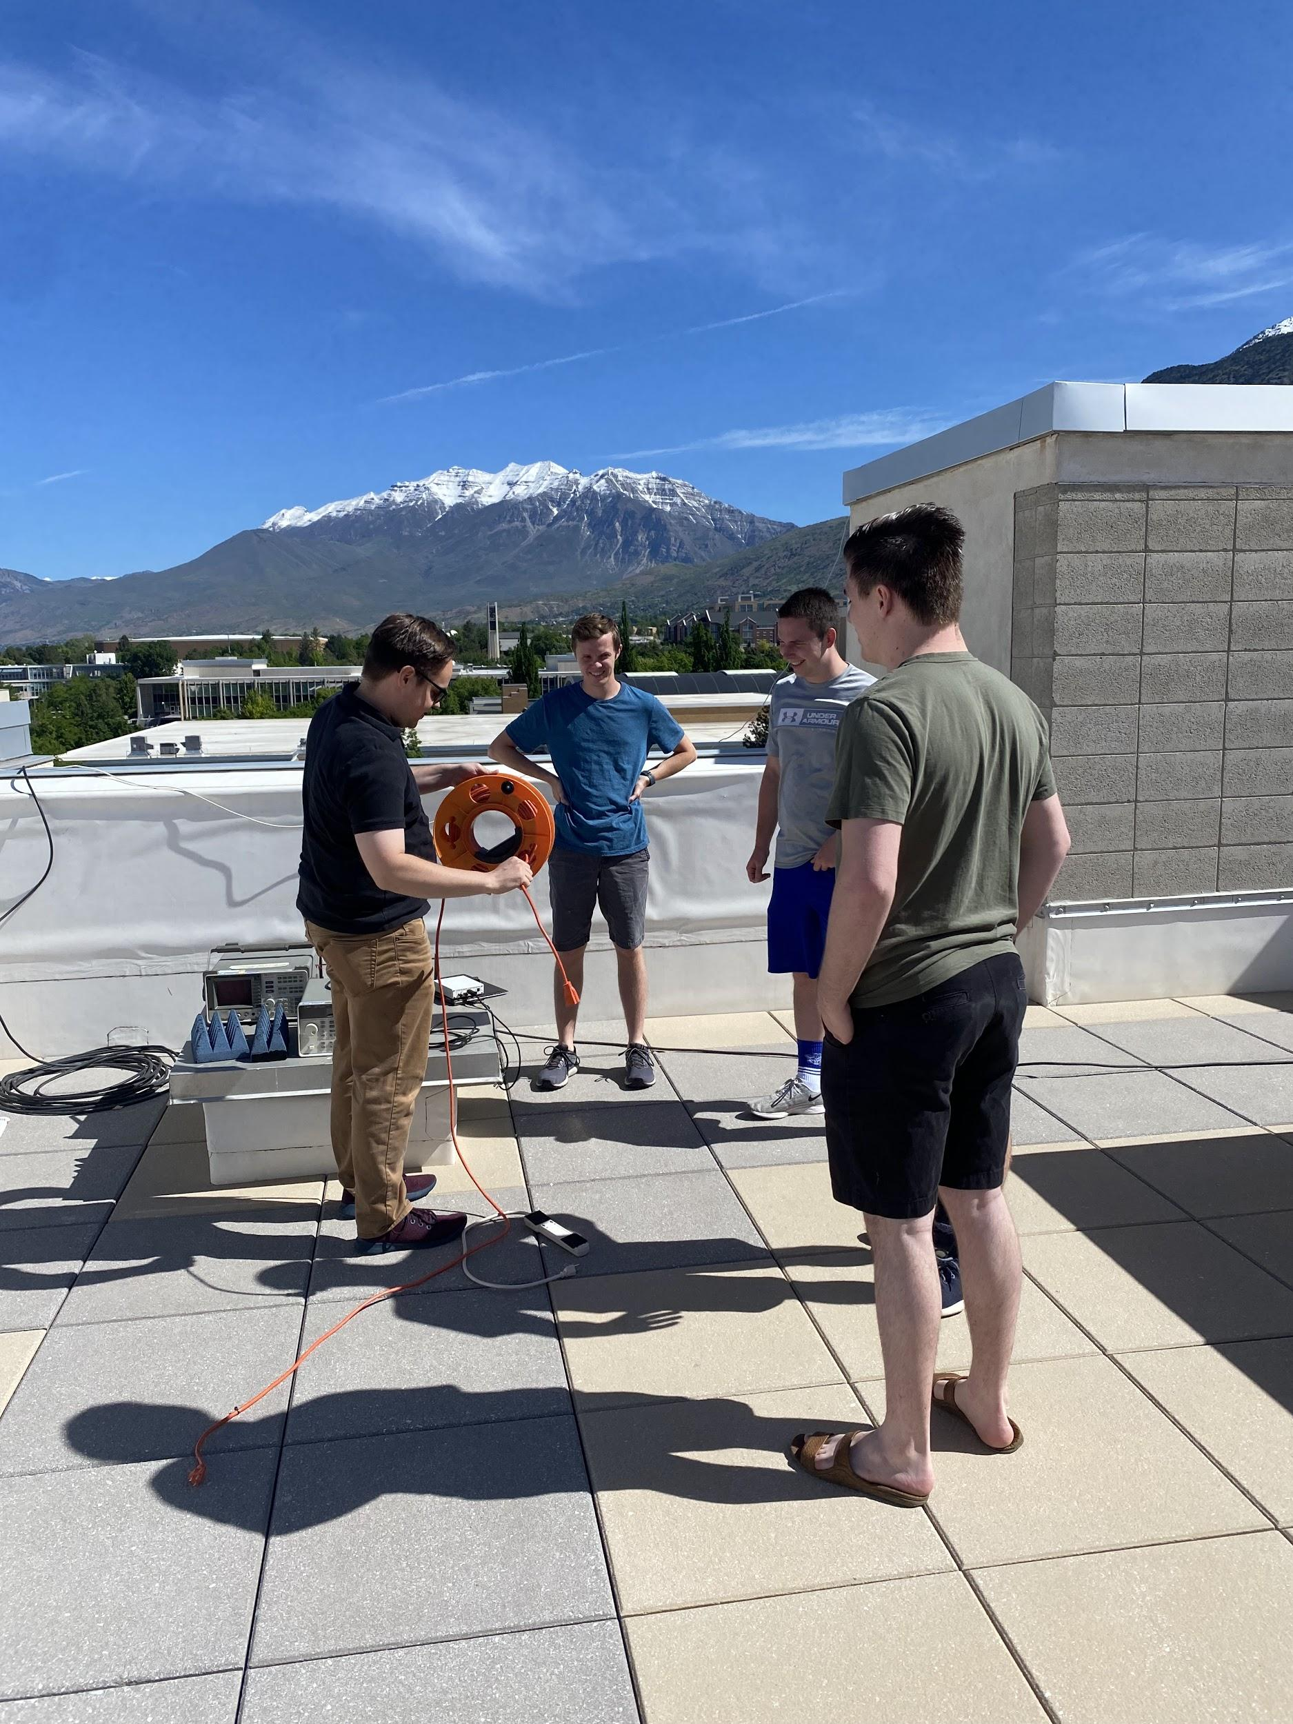
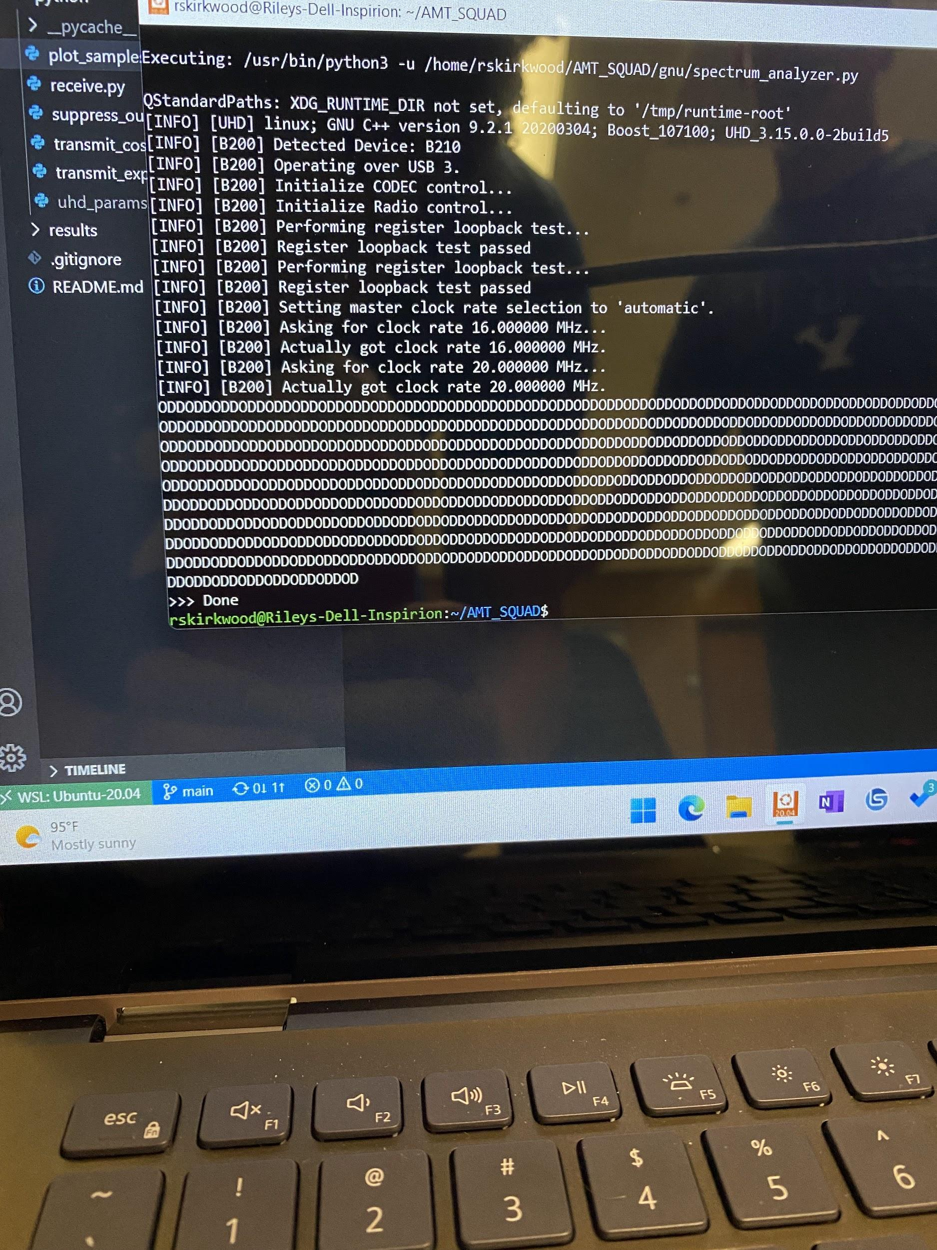
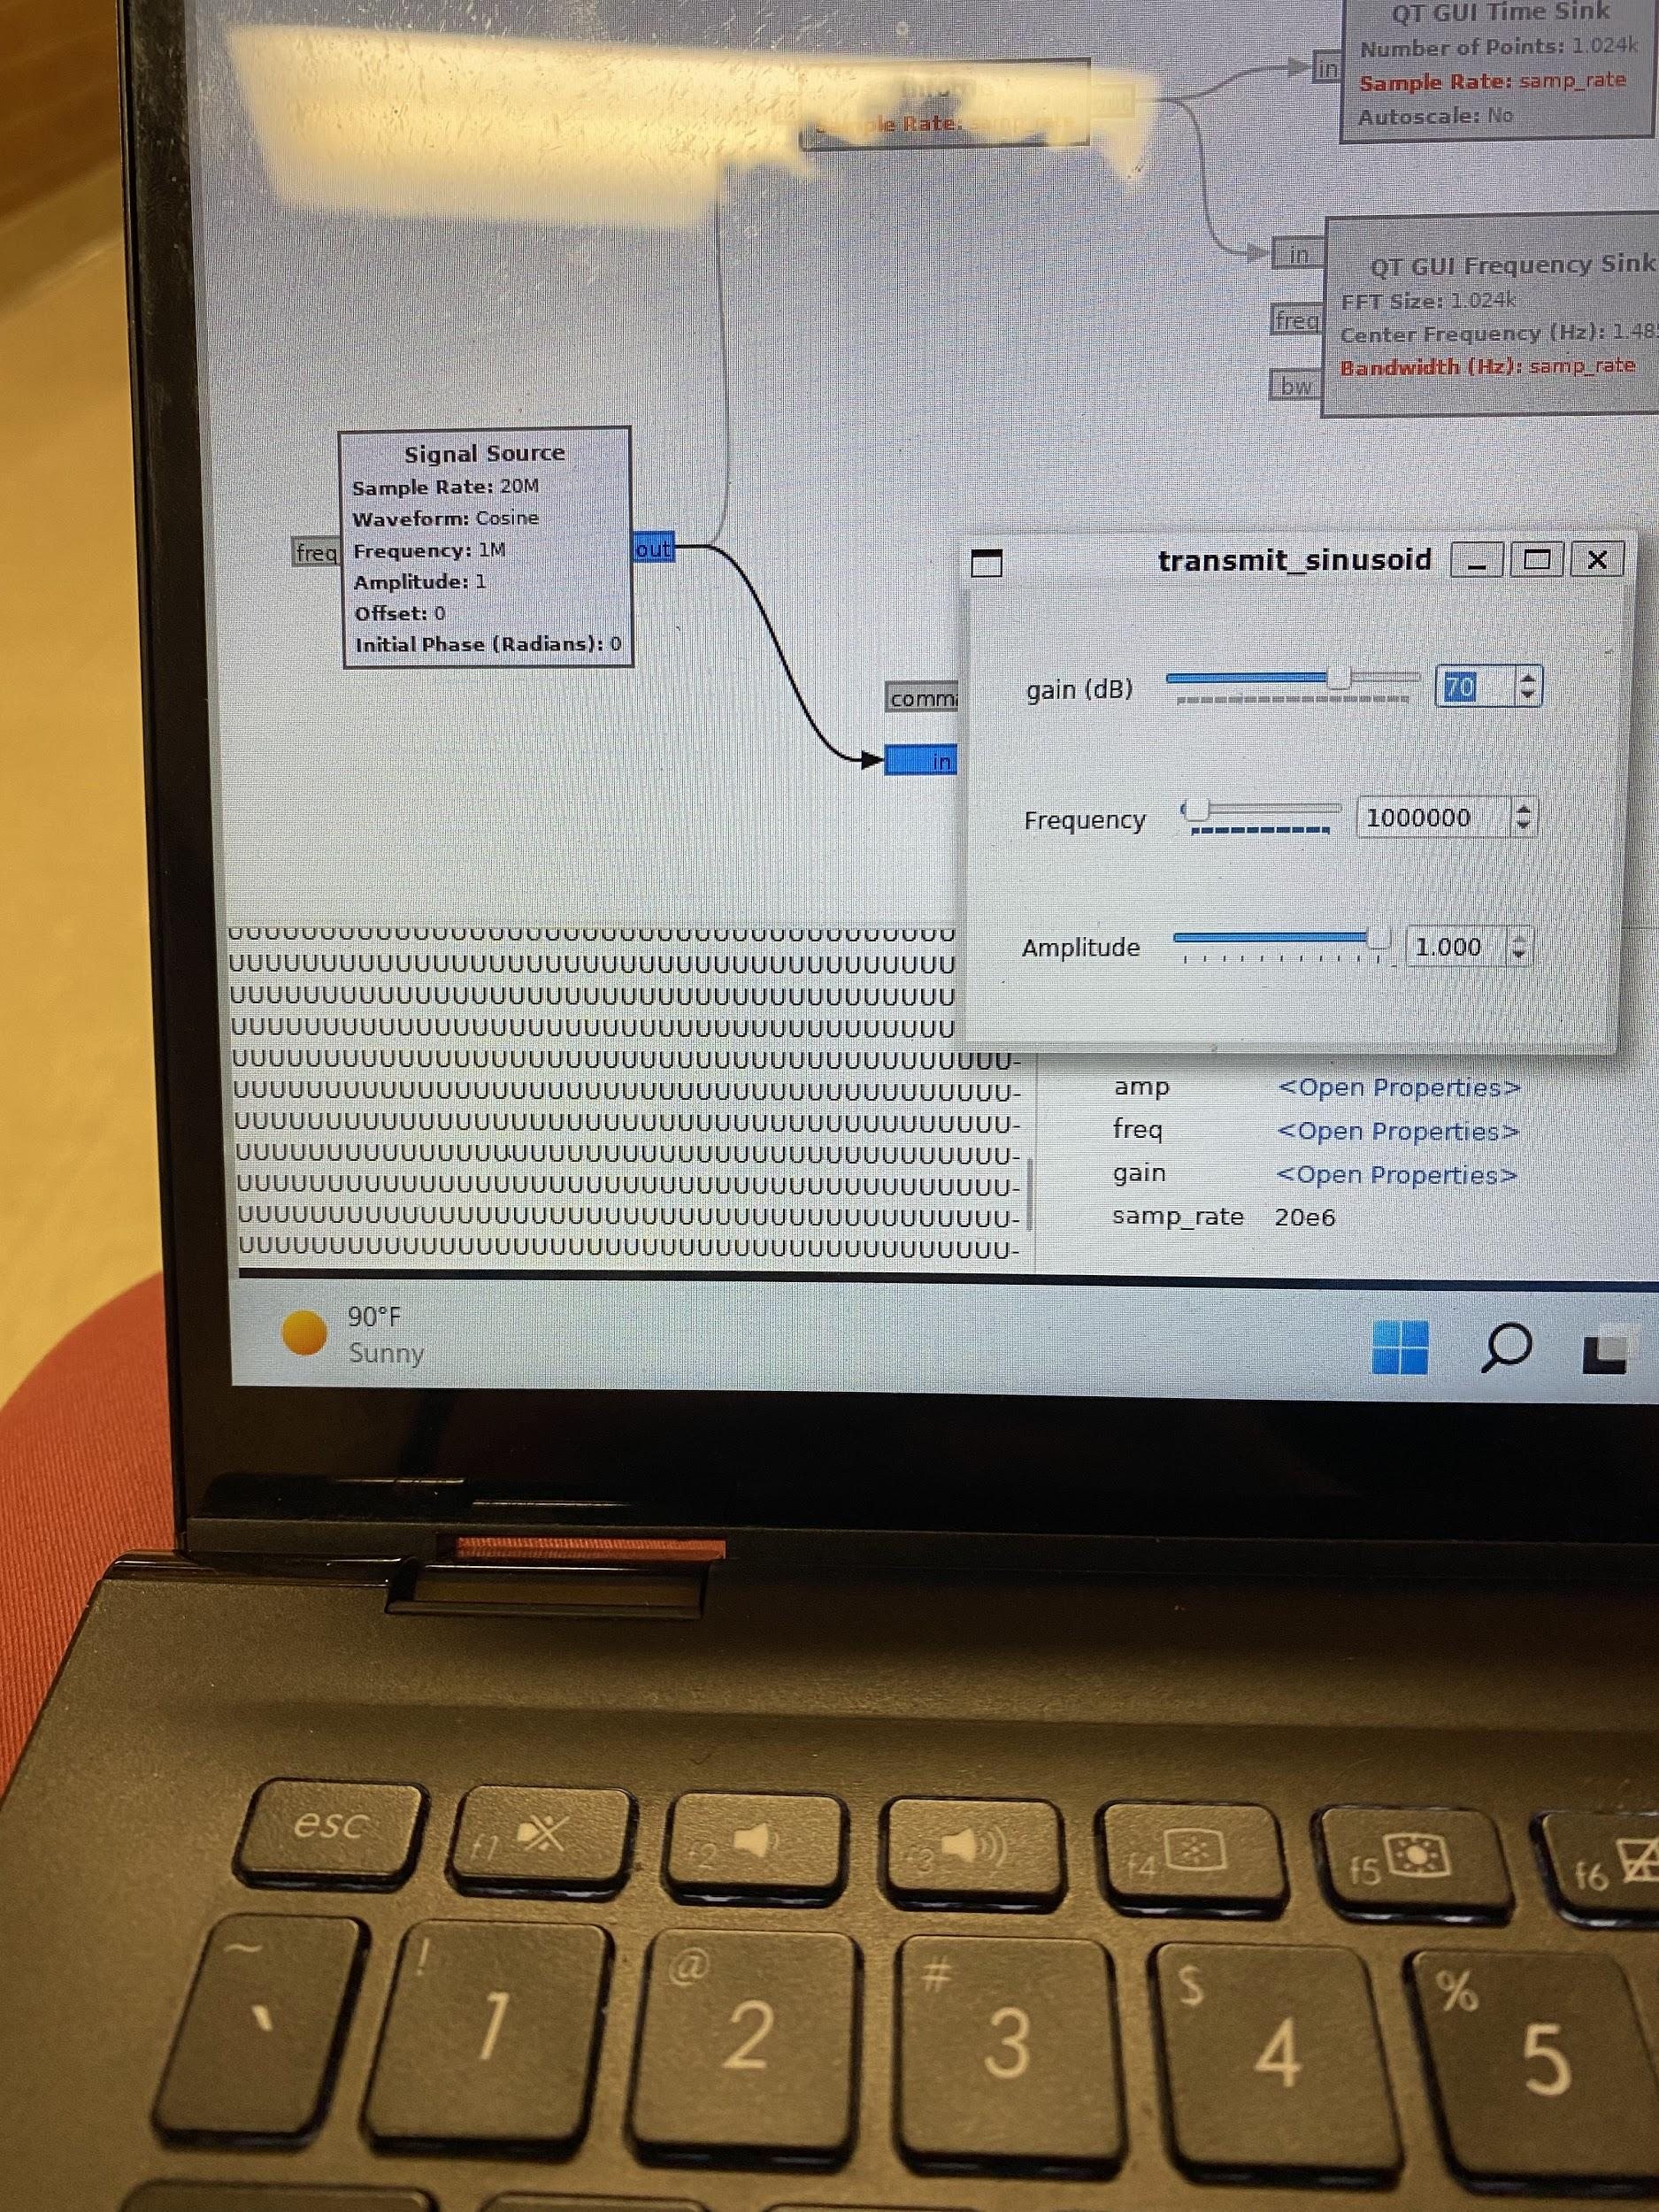
Issues with Testing
Programs used:
Python
Ubuntu
Wsl
Cmake
Matlab
Gnu radio companion
Docker
Antennas not polarized
Computers not fast enough

Slide 10
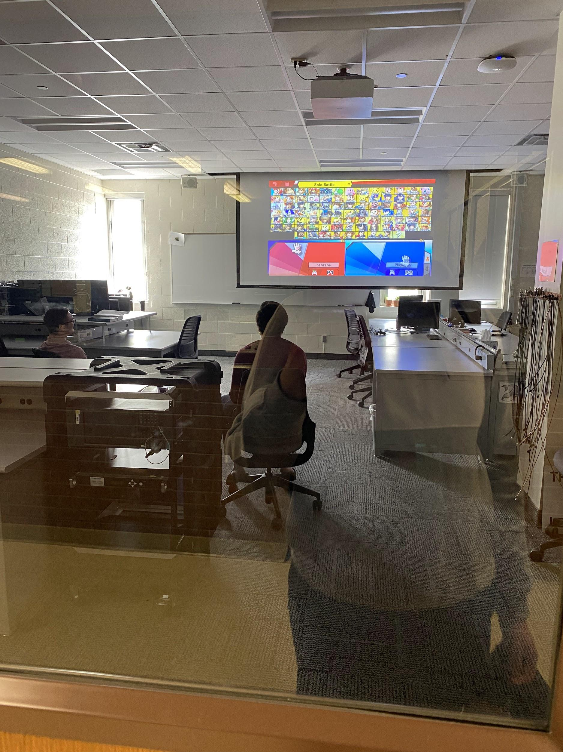
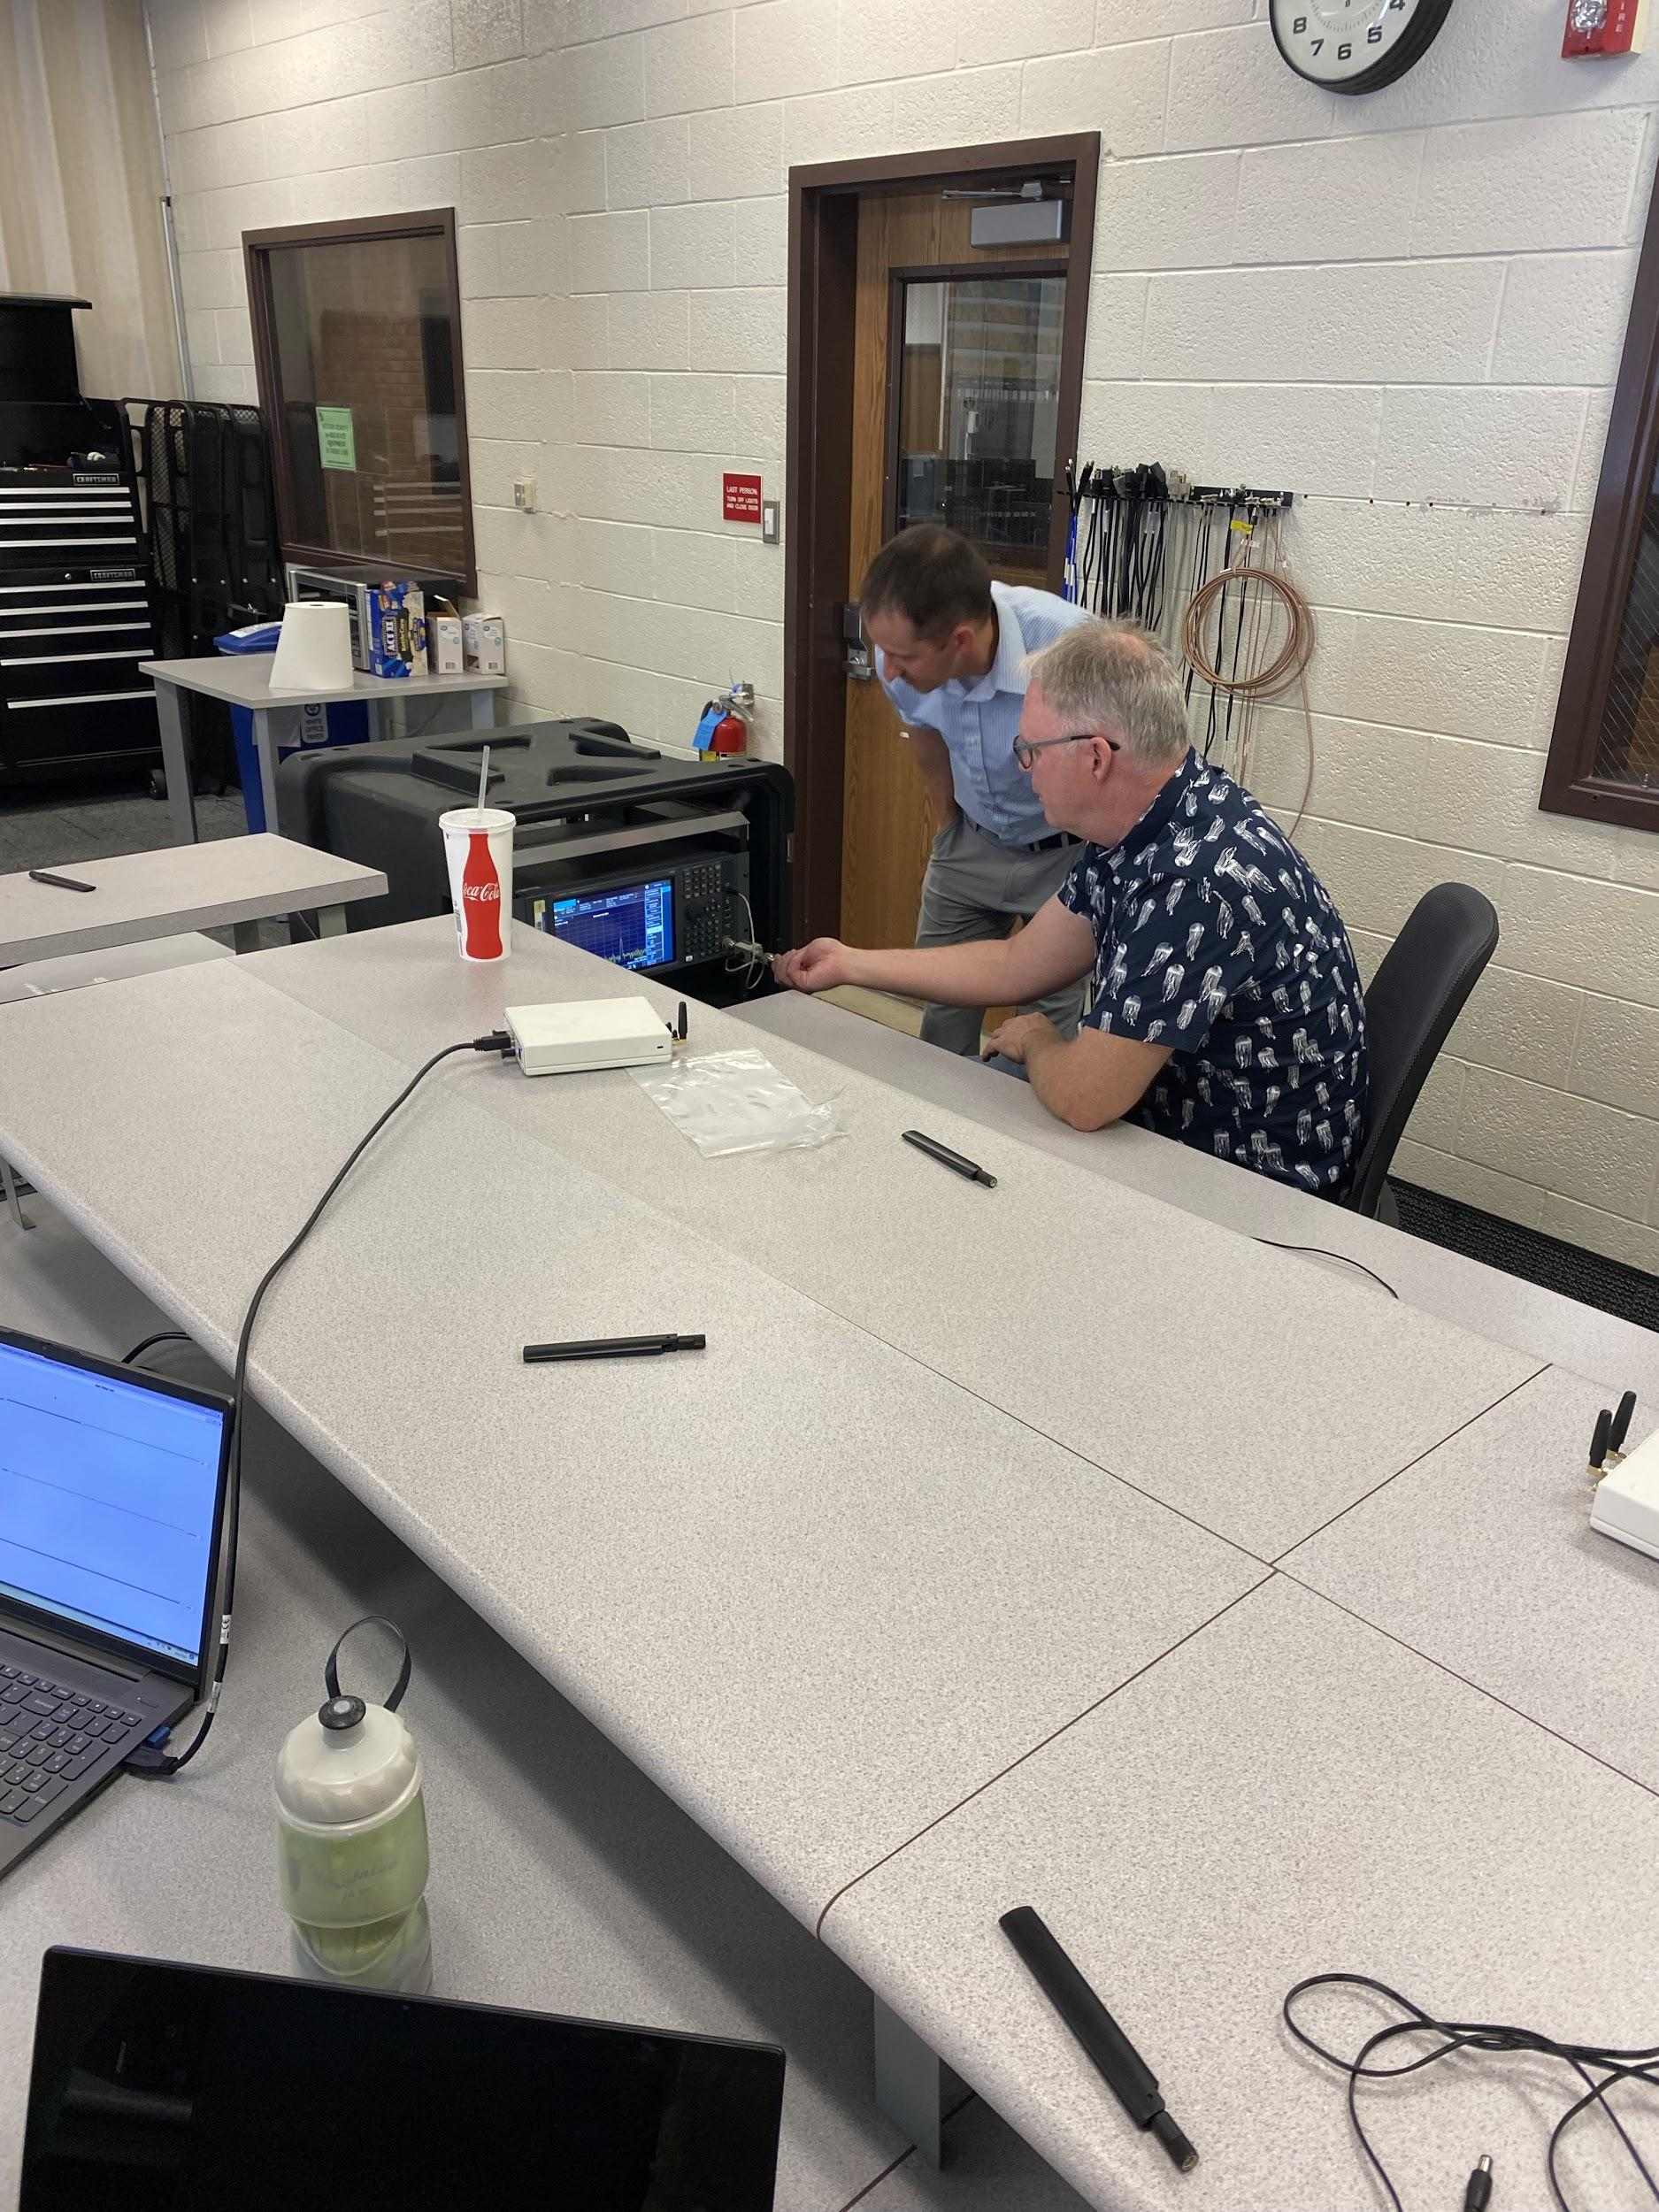
Solution
Matlab:
Divide what we were sampling by 10
Ignore first 10,000 samples from radio

Slide 11
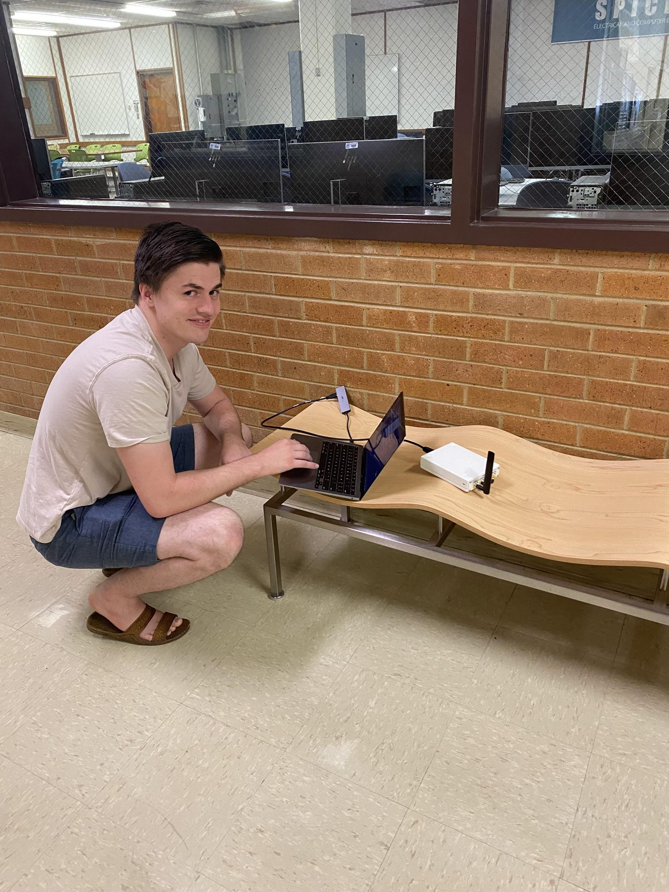
Going Forward
Test at various angles
Learn to use simulink
Find transfer function
Hallway simulates airplane flight
Compare ML to MRC
Determine what is better

Slide 12
Ethical Considerations
Accuracy in testing
Lives on the line

Slide 13
Summary
Maximum Likelihood may be a better method than MRC for data transmission

